Slide 1
Statistic matching
苗鈺(RE6111016),蔡昇翰(R28114014),林詠晴(H24096045)

Slide 2
Table of contents
introduction
Matching Methods
Propensity Score
example

Slide 3
introduction

Slide 4
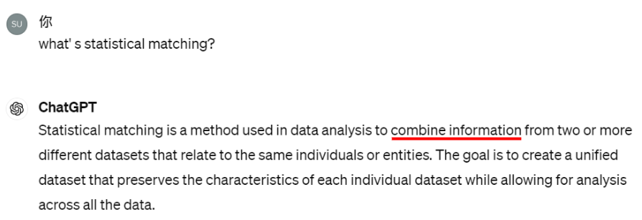
What’ s statistical matching

Slide 5
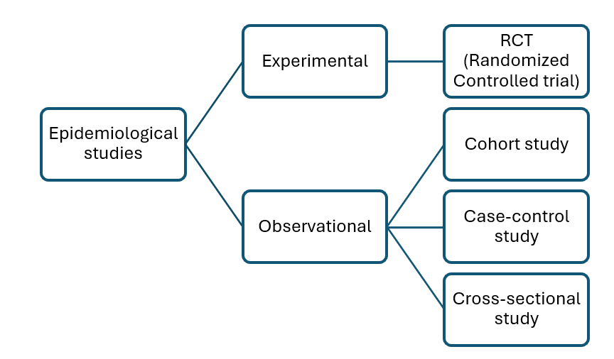
Types of Epidemiological studies

Slide 6

Why do we need statistical matching?

Slide 7
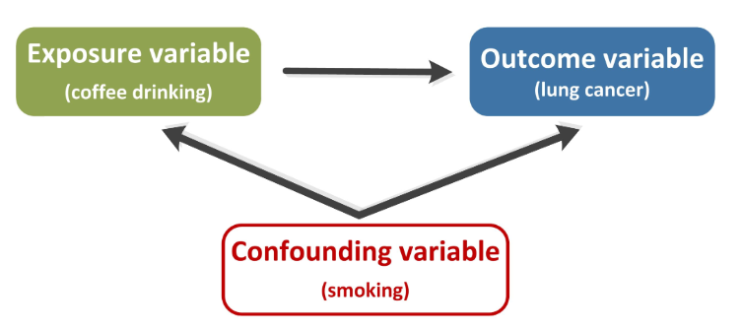
Why do we need statistical matching?

Slide 8
Assumptions
1.Conditionally independent(matching variables v.s. confounding factors)
2.Validity of matching variables
3.Availability and quality of data
4.Appropriate selection of Matching method

Slide 9
Main objectives
1.Data Completeness Enhancement (Data imputation, transformation, and filtering)
2.Bias Reduction
3.Comparability

Slide 10
Matching Methods

Slide 11
Nearest Neighbor Matching
Description:
Match each treated unit with the closest control unit based on a defined distance or similarity metrics
Pros:
Simple to implement, computationally efficient.
Cons:
May not always find the best matches, sensitive to choice of distance metric.

Slide 12
Nearest Neighbor Matching
Euclidean Distance 歐氏距離：$d\left(x,y\right)=\sqrt{\sum_{i=1}^{n}{{\left(x_{i}−y_{i}\right)}^{2}})}$
Manhattan Distance 曼哈頓距離：$d\left(x,y\right)=\left|x_{1}−x_{2}\right|+\left|y_{1}−y_{2}\right|$
Cosine Similarity 餘弦相似度：$similarity\left(x,y\right)=\frac{x×y}{\left|x\right|\left|y\right|}$
Mahalanobis Distance 馬氏距離：$d\left(x,y\right)=\sqrt{{\left(x−y\right)}^{T}S^{−1}\left(x−y\right)}$

Slide 13
Nearest Neighbor Matching
Description:
Match each treated unit with the closest control unit based on a defined distance or similarity metrics
Pros:
Simplicity; No assumptions
Cons:
Sensitive to outliers; Requires large sample sizes; Incomplete Matches

Slide 14
Optimal Pair Matching
Description:
Finds the best pairings between treated and control units to minimize the average within-pair distance or maximize the similarity between pairs.
Pros:
Produces robust matches
Cons:
More computing resources and time may be required.

Slide 15
Genetic Matching
Description:
Based on the standard Mahalanobis distance along with a weighting matrix $W$, where $W$ is a diagonal matrix with scaling factors $w$.
$$d\left(x,y\right)=\sqrt{{\left(x−y\right)}^{T}S^{−1/2}{WS}^{−1/2}\left(x−y\right)}$$
Pros:
Get more accurate information about the effect from covariates.
Cons:
Computationally intensive, may require tuning of algorithm parameters.

Slide 16
Exact Matching
Description:
Requires each treated unit to be exactly matched with one or more control units on specified covariates.
Pros:
Reduced Confounding Effects
Cons:
Limited Sample Size; Potential for Selection Bias

Slide 17
Propensity Score

Slide 18
Causal effect
$$D:\text{treatment indicator};X∈ℝ^{p}:\text{covariate of subjects}$$
$$Y\left(1\right):\text{ effect of treatment},Y\left(0\right):\text{effect of NO treatment}$$
$$Y_{i}=D_{i}Y_{i}\left(1\right)+\left(1−D_{i}\right)Y_{i}\left(0\right):\text{outcome of ith subject}$$
$$\text{Treatment effect }τ_{i}=Y_{i}\left(1\right)−Y_{i}\left(0\right),\text{ (SUTVA, Rubin)}$$
$$τ=Ε\left(Y\right)=Ε\left(Y\left(1\right)−Y\left(0\right)\right)$$

Slide 19
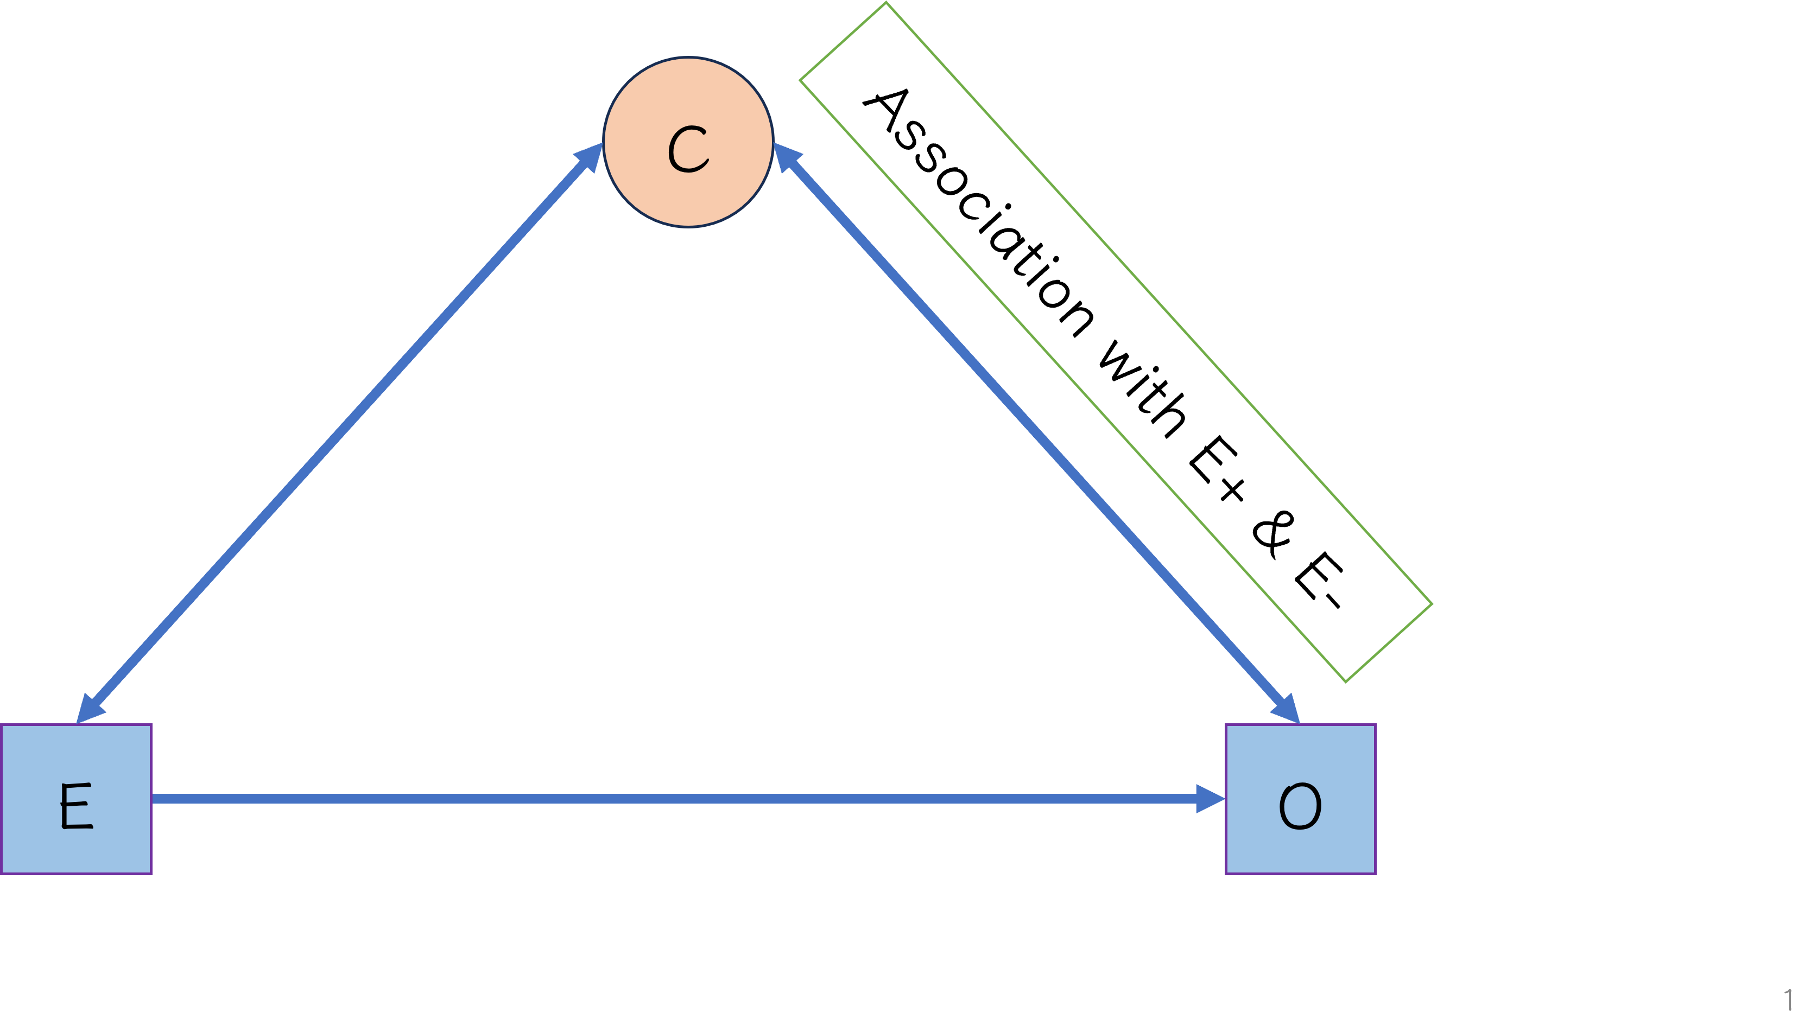
Confounding factor

Slide 20
RCT vs. Non-RCT
$$\text{Treatment: }Ε\left(Y\left(1\right)|D=1\right)$$
$$\text{Control: }Ε\left(Y\left(0\right)|D=0\right)$$
RCT:
$$τ=\left(Y\left(1\right)−Y\left(0\right)\right)=Ε\left(Y\left(1\right)−Y\left(0\right)|D\right)=Ε\left(Y\left(1\right)|D=1\right)−Ε\left(Y\left(0\right)|D=0\right)$$
Observational study
$$Ε\left(Y\left(1\right)\right)≠Ε\left(Y\left(1\right)|D=1\right)$$

Slide 21
Strongly ignorable assumption
Unconfoundedness:
$$\left(Y\left(0\right),Y\left(1\right)\right)⫫D|X,a.s.$$
Common support:
$$0<p\left(X\right)=P\left(D=1|X\right)<1,a.s.$$

Slide 22


Propensity score
Paul R. Rosenbaum
Donald B. Rubin

Slide 23
Balancing score
Balancing score
$$b\left(X\right):X⫫D|b\left(X\right)$$
Propensity score:
$$p\left(X\right)=P\left(D=1|X\right)$$

Slide 24
Property of Propensity Score
Balancing score
$$X⫫D|p\left(X\right)$$
Strongly ignorable
$$\text{X strongly ignorable}→p\left(X\right) \text{strongly ignorable}$$
$$\left(Y\left(0\right),Y\left(1\right)\right)⫫D|p\left(X\right)$$
$$τ=Ε\left(Y\left(1\right)－Y\left(0\right)\right)=Ε_{p\left(X\right)}\left(Ε\left(Y\left(1\right)−Y\left(0\right)|p\left(X\right)\right)\right)=E_{p\left(X\right)|D}\left(E\left(Y\left(1\right)|D=1,p\left(X\right)\right)−Ε\left(Y\left(0\right)|D=0,p\left(X\right)\right)\right)$$

Slide 25
Process
Study design
PS estimation
Check PS balance
Construct comparable groups
Check covariate balance
Analysis
Effect estimation
Sensitivity analysis

Slide 26
Step 1 Estimating propensity scores
Parametric or nonparametric estimation: discriminant function, probit, ML (generalized boosted model…)…
In RCT: pre-define treatment ratio
NO outcome information now

Slide 27
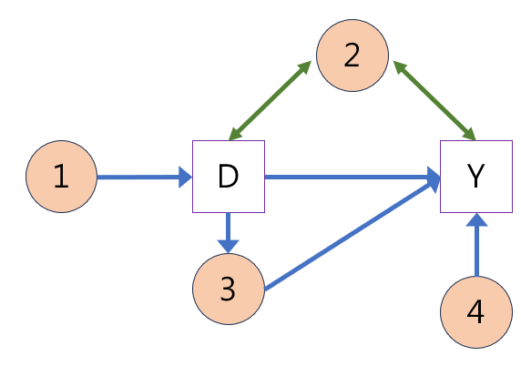
Variable selection
Domain knowledge
All baseline covariates(1+2)
Instrumental variable (1)
All covariates affect the outcome (potential confounders) (4)
Covariates affect both treatment and outcome (true confounders)
Covariate affected by treatment (3)

Slide 28
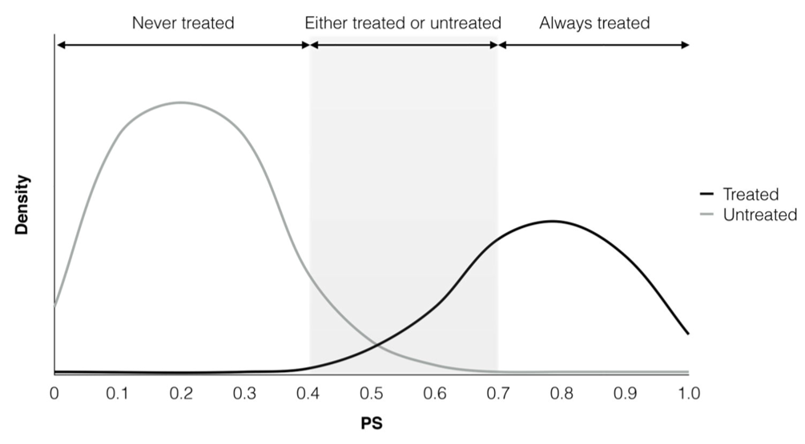
Step 2 Checking balance

Slide 29
Step 3 Construct comparison group
Type of effect: ATE or ATT, depend on aim of study
Average treatment effect (ATE):
$$τ=Ε\left(τ_{i}\right)=Ε\left(Y\left(1\right)−Y\left(0\right)\right)$$
Average treatment effect on the treated (ATT):
$$τ_{ATT}=Ε\left(τ_{i}|D=1\right)=Ε\left(Y_{i}\left(1\right)−Y_{i}\left(0\right)|D=1\right)$$

Slide 30
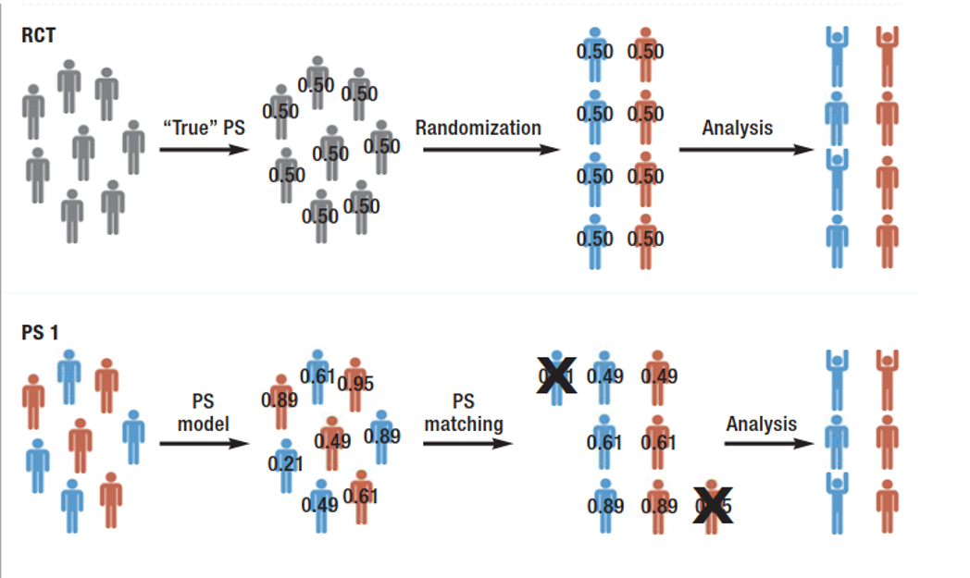
Kuss O. Dtsch Arztebl Int 2016; 113: 597–603.

Slide 31
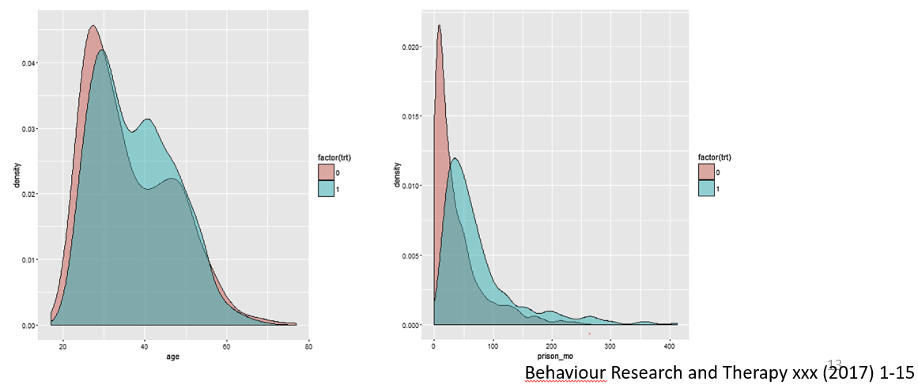
Step 4 Checking balance
Violation of ignorable assumption?

Slide 32
PS matching
Distance = PS or logit of PS
With(out) replacement
Dependent samples
Ratio: 1:1, 1:N, variable
Bias variance trade-off
May not use full data

Slide 33
PS matching
Greedy (Nearest neighbor) or optimal
With or without Caliper
0.25*$SD_{logitofPS}$ (standardized difference) (Rubin 2015); variable caliper
Kernel matching

Slide 34
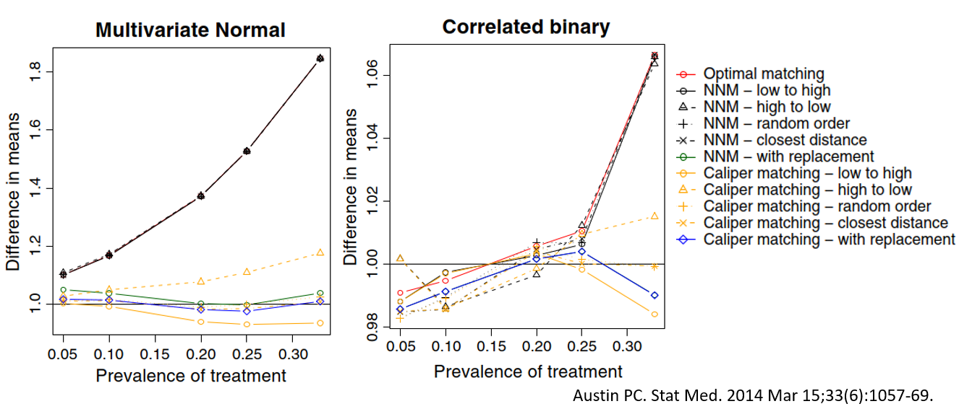
Bias
Replacement > nonreplaced; Caliper > nearest neighbor

Slide 35
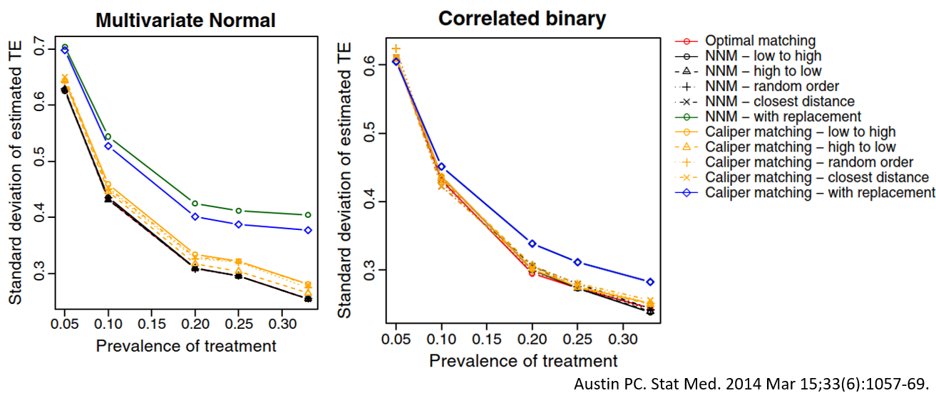
Variance
Replacement < nonreplaced; Caliper > nearest neighbor

Slide 36
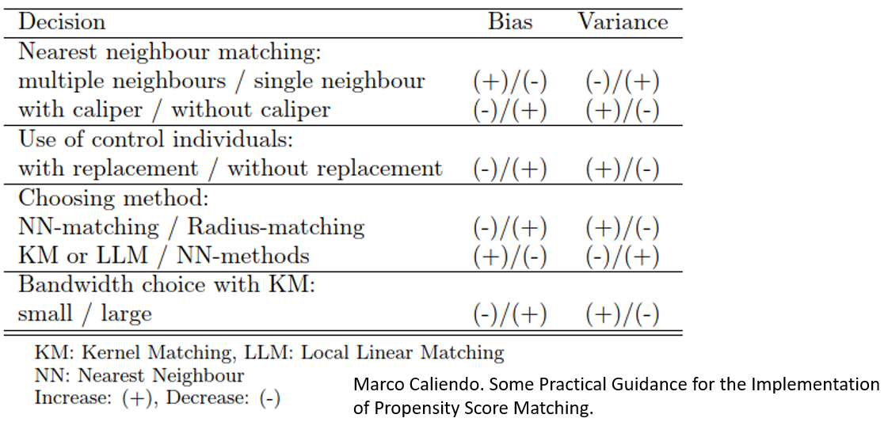
Trade-offs between Bias and efficiency

Slide 37
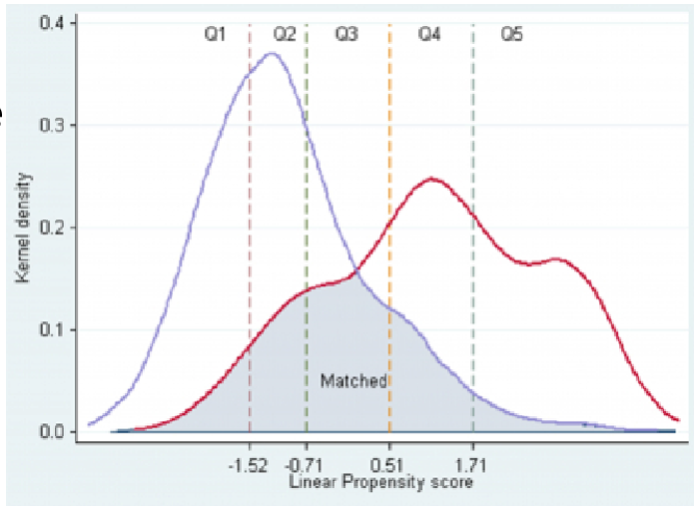
5-10 equal size strata : remove ~ 90% bias due to measured confounders (Cochran, 1968).
More strata vs. lower bias Full matching
Wang, Zhiqiang. The Internet Journal of Epidemiology 2008: 1-21.

Slide 38
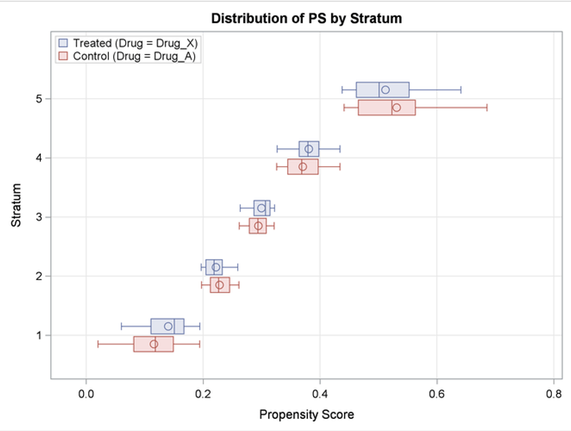
https://documentation.sas.com/doc/en/statcdc/14.2/statug/statug_psmatch_examples02.htm

Slide 39
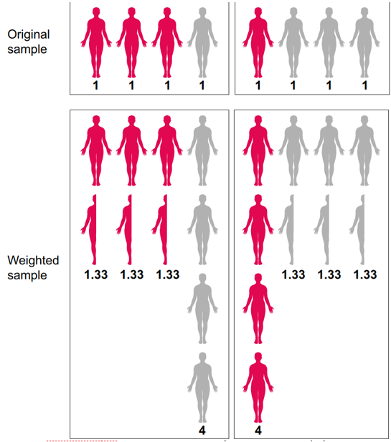
Inverted probability of treatment weighted (IPTW)
$$w=D/PS+\left(1−D\right)/\left(1−PS\right)$$
$$w_{ATT}=D+PS/\left(1−PS\right)∗\left(1−D\right)$$
All data used

Slide 40
Step 5. Estimate treatment effect
ATT (treated) or ATE (general)
Residual imbalance
(±) Regression method

Slide 41
Matching
1.Paired method (Austin, 2009): McNemar, stratified log rank…
2.Match ratio
Inference on only matched population?

Slide 42
Stratification
Both ATT and ATE
Meta-analysis of quasi-RCT
Effect: (weighted) average of strata effect

Slide 43
IPTW
ATE or ATT
Large variance if extreme weight
Doubly robustness:
$$τ̂=\frac{1}{N}\sum_{1}^{N}{\left(\frac{\left(D_{i}\left(Y_{i}−μ̂_{1}\left(X_{i}\right)\right)\right)}{p\left(X_{i}\right)}+μ̂_{1}\left(X_{i}\right)\right)}−\frac{1}{N}\sum_{1}^{N}{\left(\frac{\left(1−D_{i}\right)\left(Y_{i}−μ̂_{0}\left(X_{i}\right)\right)}{1−p\left(X_{i}\right)}+μ̂_{0}\left(X_{i}\right)\right)}$$

Slide 44
Covariate adjustment
$Y_{i}=f\left(D_{i},PS_{i}\right)+ε_{i}$
Balance?
Combine other prognostic factors (Rubin, 2000)
Reduce residual difference
Bias estimate for binary or hazard (Austin, 2007)
Need specify model (maybe incorrect?)

Slide 45
Variance estimate
Usual analysis
Matched (Imbens, 2004) vs. independent (Schafer, 2008)
Bootstrapping
Large sample distribution (Imbens, 2016)

Slide 46
Advantage of PS over regression
Conditional vs. Marginal estimate Collapsible: marginal = conditional effect
Risk ratio vs. odds ratio
Easy exam baseline balance
Lower standard deviation (Smith, 1997)

Slide 47
Advantage of PS over regression
Restricted number of confounders in the model
Confounding by indication
Modelling assumption (simpler to determine adequate score)
Model design not separated from outcome analysis

Slide 48
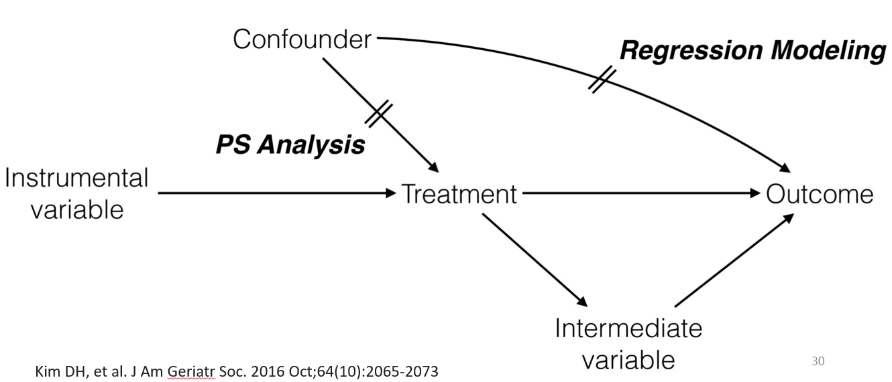
PS vs. regression

Slide 49
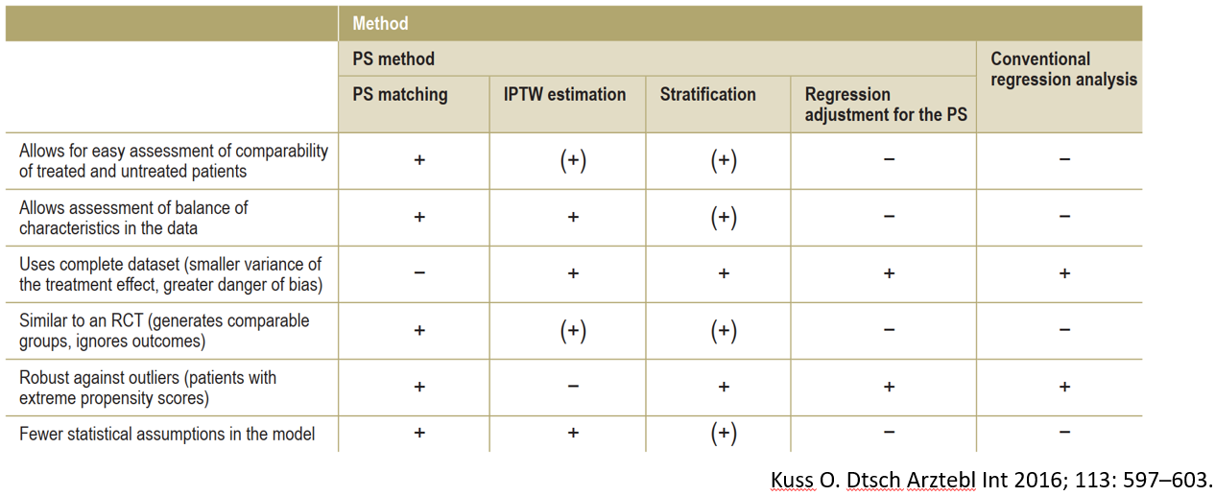
Reduce systematic difference: matching ≧(≃) weighting > stratify, adjustment

Slide 50
Step 6. Sensitivity analysis
Effect on variables unrelated to treatment
Estimates effect of variable uncorrelated to outcome (pre-treatment outcome…) (Imbens, 2004)
Analysis sensitive to unobserved variable (Rosenbaum and Rubin, 1983)

Slide 51
example

Slide 52
Package & dataset
dataset
Nycflights13
Package
MatchIt
Reference
A Step-by-Step Guide to Propensity Score Matching in R

Slide 53
Flights data
month(2013,Jan.~Dec.)
dep_delay, arr_delay
Departure and arrival delays, in minutes. Negative times represent early departures/arrivals.
Delay
Arrival on time or not。
carrier
Two letter carrier abbreviation.
air_time(min)

Slide 54
Q : is air_time affects delays?

Slide 55
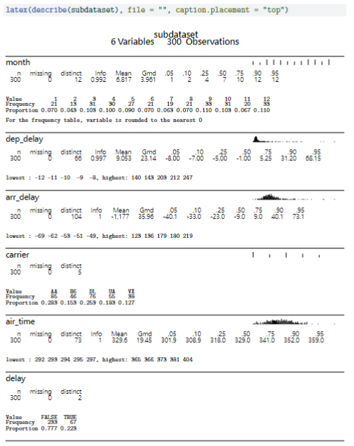
describe

Slide 56
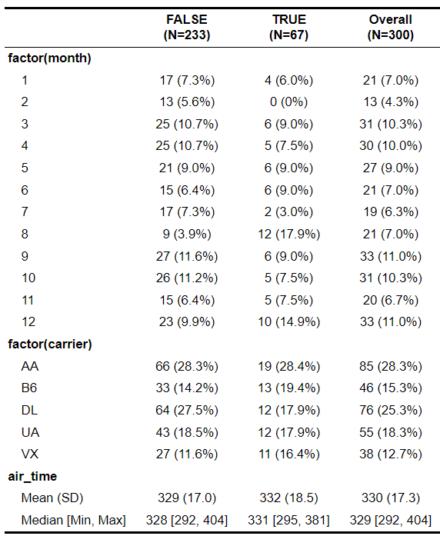
table1
The number of delays in August is higher compared to previous months.
air_time in two group perform similarly.

Slide 57
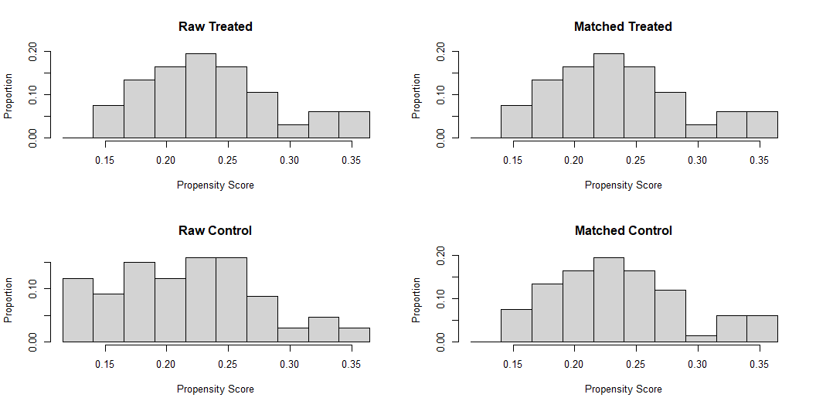
model
psm1 <- matchit(delay ~ month + carrier,method="nearest",data=subdataset,distance = "glm") s1 = summary(psm1) print(s1$nn[c(2,4,5,6),])
Control Treated All 233 67 Matched 67 67 Unmatched 166 0 Discarded 0 0
plot(psm1,type="hist")

Slide 58
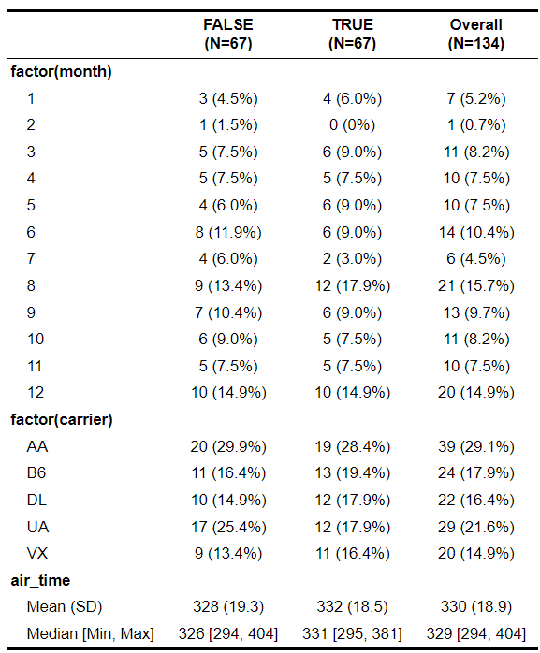
table1(after matching)
After matching, the distribution of months and carriers appears to be more evenly balanced.
air_time in two group still perform similarly.

Slide 59
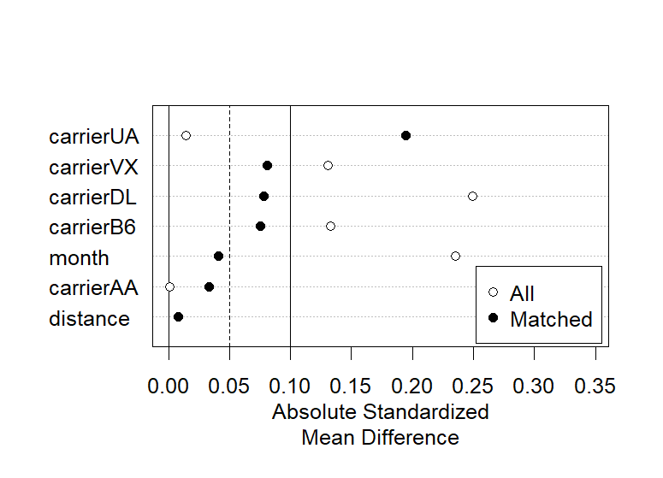
love plot

Slide 60
t-test(raw data)
If conducting a t-test directly on the raw data, at a confidence level of 0.1, under the assumption of the null hypothesis, there is no significant difference in the distance between flights with and without delays.
[1] "p_value:0.237"
[1] "90 CI :-7.164~1.185"

Slide 61
t-test(matching data)
If conducting a t-test directly on the matched data, at a confidence level of 0.1, under the assumption of the null hypothesis, there is no significant difference in the distance between flights with and without delays.
[1] "p_value:0.201"
[1] "90 CI :-9.596~1.208"

Slide 62
pair-t test(matching data)
The result of the paired t-test indicates, at a confidence level of 0.1, rejecting the null hypothesis, suggesting a significant difference in flight distances between flights with and without delays.
[1] "p_value:0.094"
[1] "90 CI :-8.306~-0.082"

Slide 63
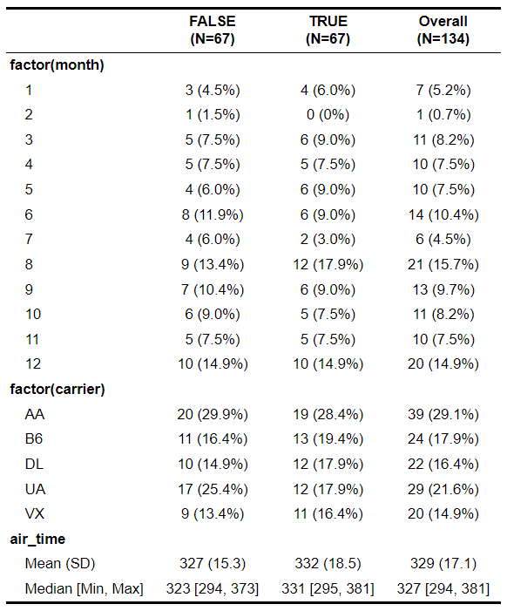
Difference in every method
Nearest Neighbor
Optimal Pair

Slide 64
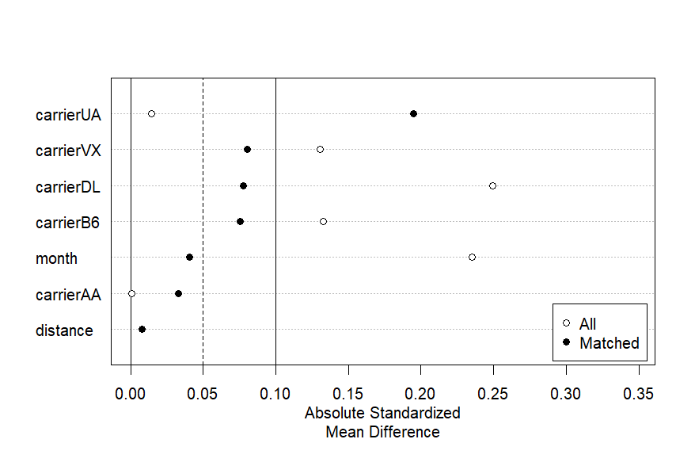
love plot(Genetic)
Optimal Pair

Slide 65
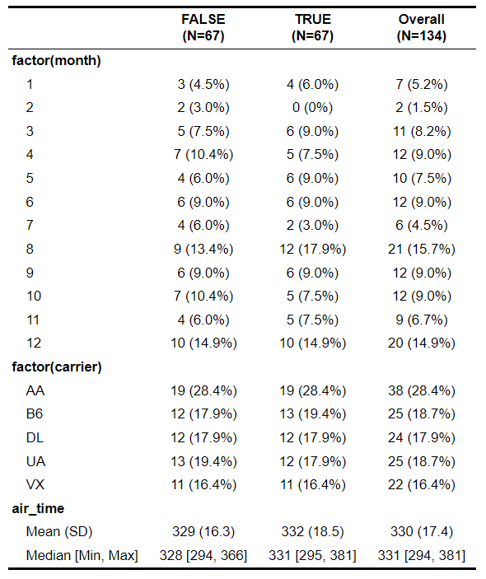
Difference in every method
Nearest Neighbor
Genetic

Slide 66
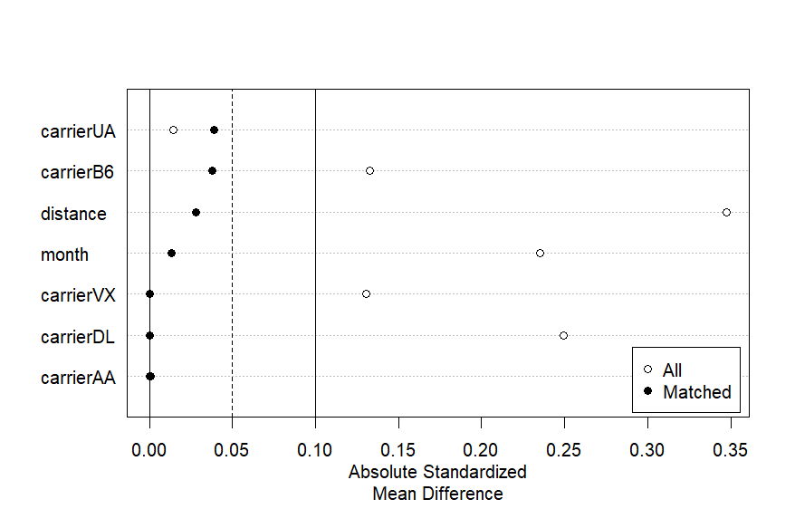
love plot(Genetic)
Genetic

Slide 67
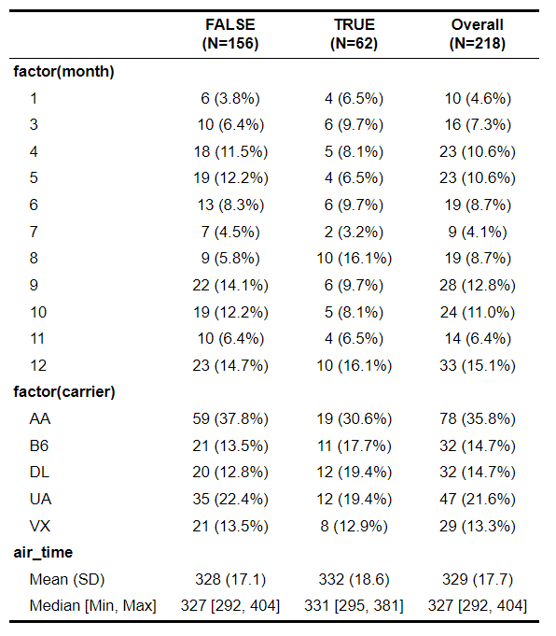
Difference in every method
Nearest Neighbor
Exact

Slide 68
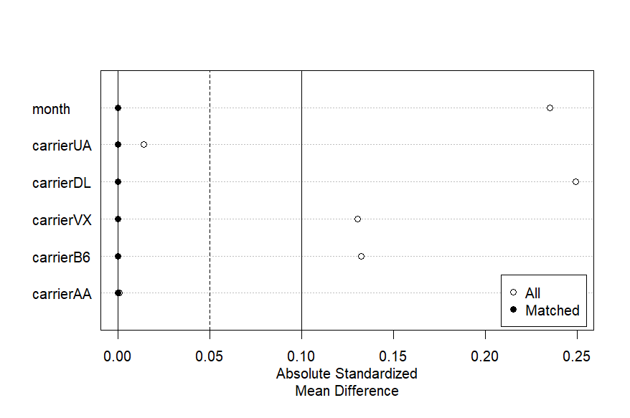
love plot(Exact)
Exact

